Slide 1
LOGIC GATE Boolean Algebra Simplification SOP-POS/Minterm-Maxterm K-Map

Slide 2
Logic Gate
Digital systems are said to be constructed by using logic gates.
These gates are the AND, OR, NOT, NAND, NOR, EXOR and EXNOR gates.
The basic operations are described below with the aid of truth tables
Truth tables are used to help show the function of a logic gate
Boolean functions practically implemented by using electronic gates
Generally logic gate have 2 input 1 output
Gate INPUTS are driven by voltages having two nominal values,
0V logic 0 and 5V logic 1
The OUTPUT of a gate provides two nominal values of voltage only
0V logic 0 and 5V logic 1

Slide 3



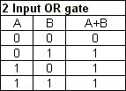
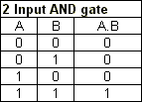

Logic Gate
AND gate
OR gate
NOT gate
produces an inverted version of the input at its output.
high output (1) if one or more of its inputs are high.
high output (1) only if all its inputs are high

Slide 4


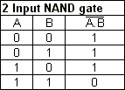
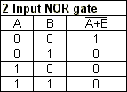
Logic Gate
NAND GATE
AND gate followed by a NOT gate.
NOR GATE
OR gate followed by a NOT gate.
Low output (0) if one or more of its inputs are high.
high output (1) only if all its inputs are low
NAND and NOR gates are called universal

Slide 5


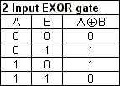
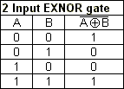
Logic Gate
EXOR GATE/XOR
EXNOR GATE/XNOR
high output (1) for different input
High output (1) for same input

Slide 6
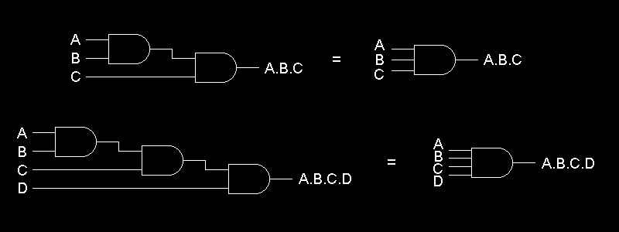
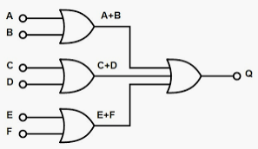
MULTI-INPUT LOGIC GATES

Slide 7
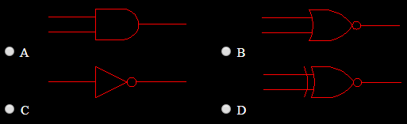
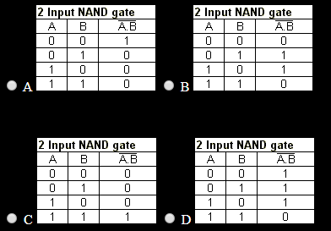
Practice Questions
Which of the following symbols represents a NOR gate?
Which one of the following truth tables represents the behavior a NAND gate?

Slide 8
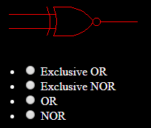
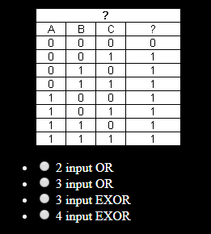
Practice Questions
What type of logic gate does this symbol represent?
What type of logic gate's behavior does this truth table represent?

Slide 9
Practice Questions
The output of an AND gate with three inputs, A, B, and C, is HIGH when ________. A. A = 1, B = 1, C = 0 B. A = 0, B = 0, C = 0 C. A = 1, B = 1, C = 1 D. A = 1, B = 0, C = 1
If the input to a NOT gate is A and the output is X, then ________. A. X = A B. A=~A C. X = 0 D. none of the above
How many inputs of a four-input AND gate must be HIGH in order for the output of the logic gate to go HIGH? A. any one of the inputs B. any two of the inputs C. any three of the inputs D. all four inputs

Slide 10
Practice Questions
Which of the following gates is described by the expression ~(ABCD) A. OR B. AND C. NOR D. NAND

Slide 11
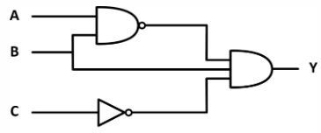
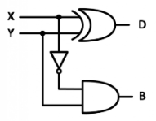
Circuit with Logic Gate

Slide 12
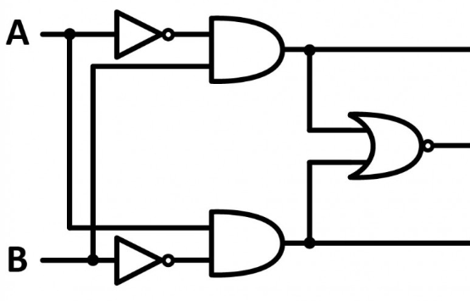
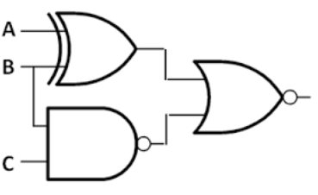
Circuit with Logic Gate

Slide 13
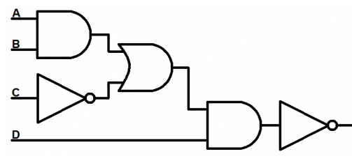
Circuit with Logic Gate
Draw circuit for

Slide 14


Boolean Algebra
Analyze and simplify the digital (logic) circuits
Variable used can have only two values. Binary 1 for HIGH and Binary 0 for LOW
Commutative law
Associative law
Distributive law
AND law
OR law
INVERSION law

Slide 15
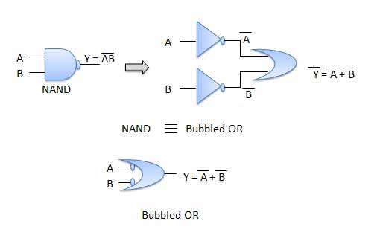

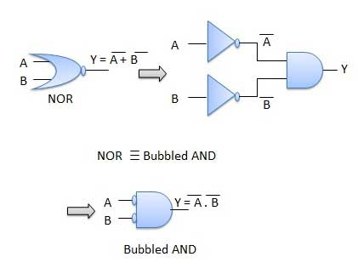

De Morgan Law

Slide 16
Simplification

Slide 17
Simplification

Slide 18
Simplification

Slide 19
Simplify and implement with minimum number of logic gates

Slide 20
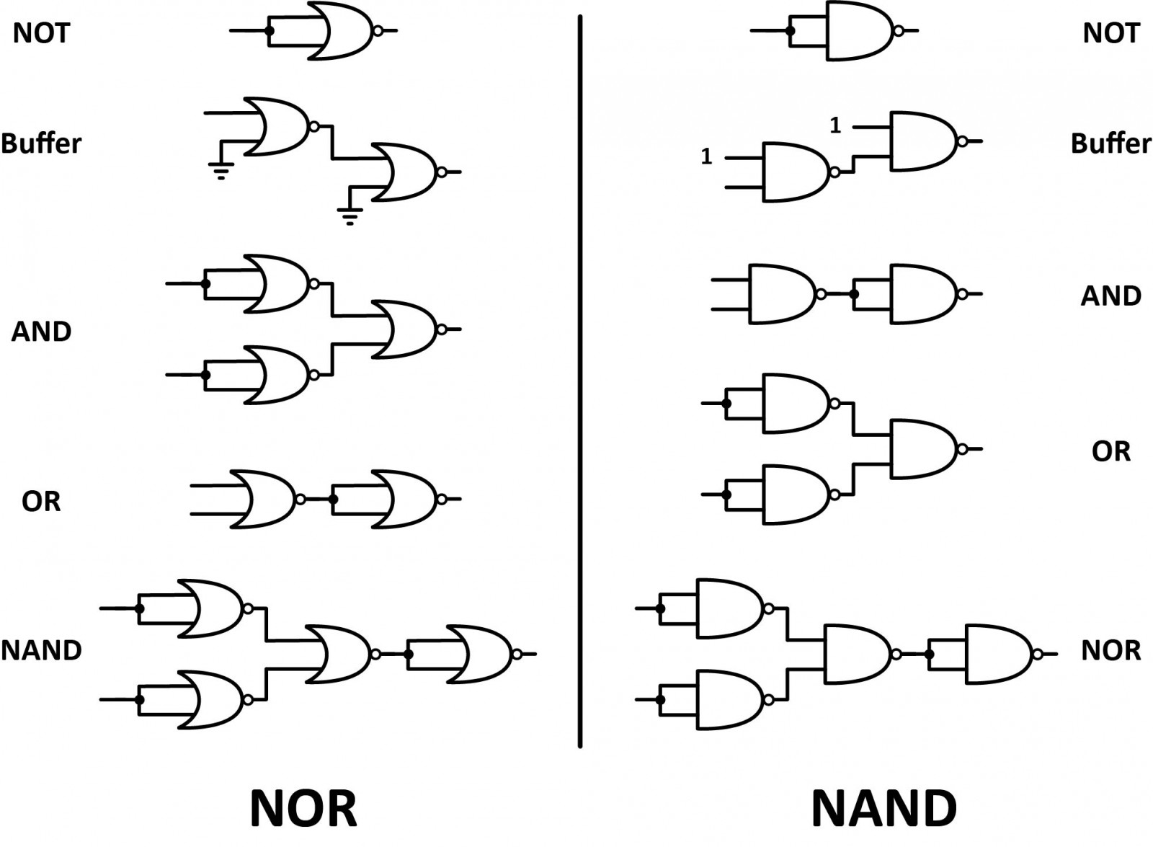
Logic Gate Implement with NAND-NOR

Slide 21
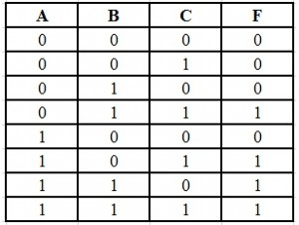
SOP-POS
Boolean function is an algebraic form of Boolean expression
Sum-of-Products (SOP) - variables are operated by AND (product) are OR(sum) together
Product-of-sums (POS) - variables are operated by OR (sum) are AND (product) together
SOP Expression
Write AND term for each input combination produces HIGH
Write the input variables for 1 and compliment for 0.
OR the AND terms to obtain the output function.
F(SOP) = A’BC + AB’C + ABC ‘ + ABC
POS Expression
Write OR term for each input combination produces LOW Write the input variables for 0 and complement for 1
AND the OR terms to obtain the output function
F(POS)= F = (A + B + C) (A + B + C ‘) (A + B’ + C) (A’ + B + C)
POS is compliment of SOP

Slide 22
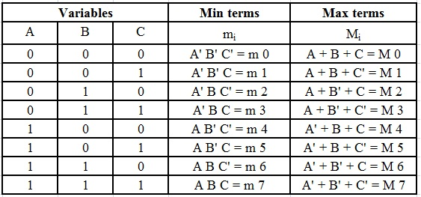
Min Term –Max Term

Slide 25
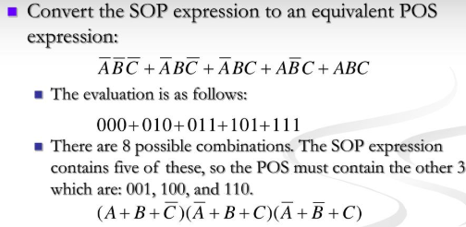
SOP-POS Conversion

Slide 26
Polling Questions
How many gates are required to realize Y = CD + EF
A) 2 AND 1 OR
B) 1 AND 2 OR
Which of following are known as universal gates?
A) NAND & NOR
B) AND & OR
The logic gate that will have HIGH or "1" at its output when any one of its inputs is HIGH
A) AND
B) OR
Which of the following equations would accurately describe a 4-input OR gate when A = 1, B = 1, C = 0 and D = 0
A) 1 + 1 + 0 + 0 = 1
B) 1 + 1 + 0 + 0 = 0

Slide 27
A small circle on the output of a logic gate is used to represent
A) NOT
B) BUF
Output will be a LOW for any case when one or more inputs are zero
A) AND
B) OR
3 input gate contains ___ number of entries in truth table
A) 8
B) 7
How many two-input AND and OR gates are required to realize Y = CD+EF+G
A) 2,3
B) 2,2
XOR output is high, if inputs are
A) Different
B) Same

Slide 28
Which is XNOR gate equation
A) AB +(~A)(~B)
~AB + A(~B)
If one input of XOR gate is connected to high terminal, equivalent to
A) NOT
B) BUF
Compliment of XOR is
A) XNOR
B) XOR
Which is not correct
A) A.1=1
B) A+A=A
A+1=1
A.A=A
(A+B)(C+D) present
A) 2 OR gate ANDed
B) 2 AND gate ORed

Slide 29
POS is compliment of SOP
A) True
B) False
min term when x=0, y=0 and z=1
A) x'y'z
B) x+y+z’
number of max terms for an expression comprising of 3 variables?
A) 8
B) 3
Y=AB+BC+AC is
A) SOP
B) POS
Y=(A+B)(B+C)(C+A) shows
A) POS
B) SOP

Slide 30
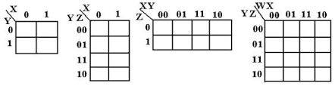
KMAP
Karnaugh map is a tool for simplification of Boolean algebra
K-Map diagram is made up of squares
K-map is a graphical representation of SOP (Minterm)
K-Map extensively reduce the calculation and provides best minimized solution
K-map solve the expression with grouping of neighbor cells
3 variable
2 variable
3 variable
4 variable

Slide 31
Kmap Simplification Rule
Construct kmap and place 1’s in the squares according to the truth table.
Groupings can contain only 1s
Groups can be formed only at right angles; diagonal groups are not allowed.
The number of 1’s in a group must be a power of 2
The groups must be made as large as possible.
Groups can overlap and wrap around the sides of the Kmap.
Every group puts a term in the solution
Optimized Solution
Minimum number of group
Each group covers maximum possible squares

Slide 32
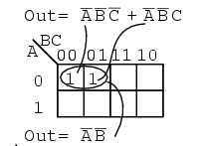
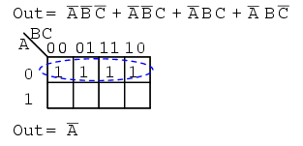
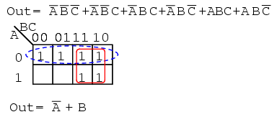
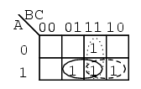
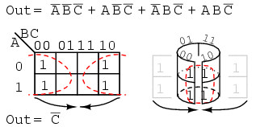
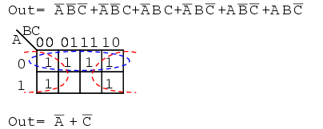

Slide 33
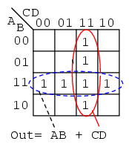

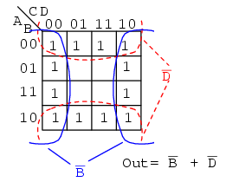

Slide 34

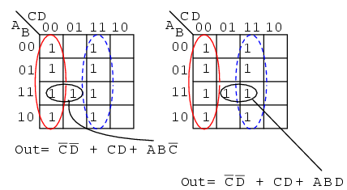
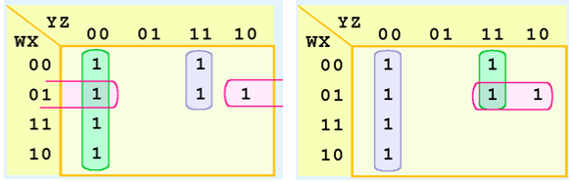

Slide 35



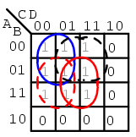
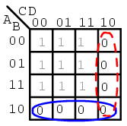

Slide 36
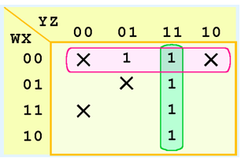
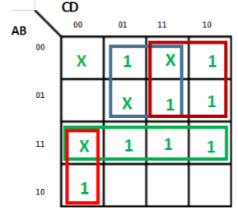

Kmap with Don’t Care
In a Kmap, a don’t care condition is identified by an X in the cell of the minterm(s)
In simplification, we are free to include or ignore the X’s when creating our groups.

Slide 37
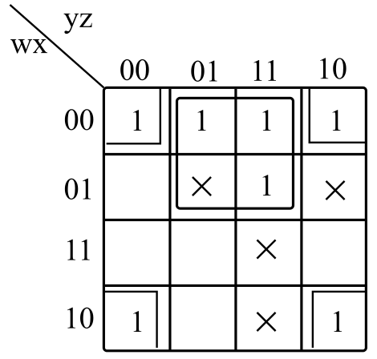

F(ABCD)=π(0,1,3) . d(5,7)

